Slide 1
Chapter 6
Process Synchronization
Narzu Tarannun(NAT)
Lecturer
CSE Department
Brac University

Slide 2
Background
Processes can execute concurrently
Concurrent access to shared data may result in data inconsistency
Maintaining data consistency requires mechanisms to ensure the orderly execution of cooperating processes
Notes:
Bounded buffer : assumes a fixed buffer size, in this case the consumer must wait if the buffer is empty and producer must wait if the buffer is full.

Slide 3
Process Synchronization: Objectives
Concept of process synchronization.
The critical-section problem, whose solutions can be used to ensure the consistency of shared data
Software and hardware solutions of the critical-section problem
Classical process-synchronization problems
Tools that are used to solve process synchronization problems

Slide 4
What will Cover………………
Process Synchronization basic Concepts
The Critical-Section Problem
Peterson’s Solution
Synchronization Hardware
Semaphores
Classic problems of synchronization

Slide 5
Process Synchronization
Process Synchronization means sharing system resources by processes in a such a way that, Concurrent access to shared data is handled thereby minimizing the chance of inconsistent data. Maintaining data consistency demands mechanisms to ensure synchronized execution of cooperating processes.
Process Synchronization was introduced to handle problems that arose while multiple process executions.

Slide 6
Illustration….
Suppose that we wanted to provide a solution to the consumer-producer problem that fills all the buffers(actually support bounded buffer). We can do so by having an integer count that keeps track of the number of full buffers. Initially, count is set to 0. It is incremented by the producer after it produces a new buffer and is decremented by the consumer after it consumes a buffer.

Slide 7
Producer
while (true)
/* produce an item and put in nextProduced
while (count == BUFFER_SIZE)
; // do nothing
buffer [in] = nextProduced;
in = (in + 1) % BUFFER_SIZE;
count++;
}

Slide 8
Consumer
while (1)
{
while (count == 0)
; // do nothing
nextConsumed = buffer[out];
out = (out + 1) % BUFFER_SIZE;
count--;
/* consume the item in nextConsumed
}

Slide 9
Race Condition
count++ could be implemented as
register1 = count
register1 = register1 + 1
count = register1
count-- could be implemented as
register2 = count
register2 = register2 - 1
count = register2
Consider this execution interleaving with “count = 5” initially:
  S0: producer execute register1 = count {register1 = 5}
  S1: producer execute register1 = register1 + 1 {register1 = 6}
  S2: consumer execute register2 = count {register2 = 5}
  S3: consumer execute register2 = register2 - 1 {register2 = 4}
  S4: producer execute count = register1 {count = 6 }
  S5: consumer execute count = register2 {count = 4}

Slide 10
Race Condition
A situation where several processes access and manipulate the same data concurrently, and the outcome of the execution depends on the particular order in which the access takes place, is called race condition.
To guard against the race condition above, we need to ensure that only one process at a time can be manipulating the variable counter. To make such a guarantee , we require that the processes be synchronized in some way.

Slide 11
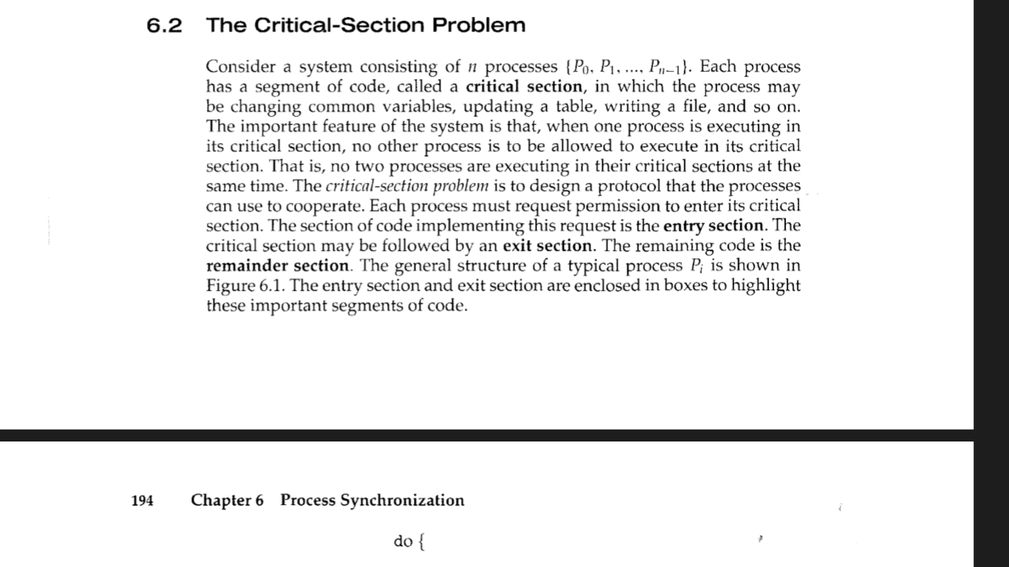
Critical Section Problem

Slide 12

Critical Section Problem

Slide 13
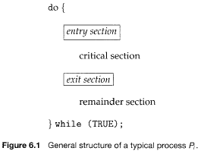
Critical Section

Slide 14
Solution to Critical-Section Problem
A solution to the critical-section problem must satisfy the following three requirements:
1. Mutual Exclusion - If process P_{i} is executing in its critical section, then no other processes can be executing in their critical sections
2. Progress - If no process is executing in its critical section and there exist some processes that wish to enter their critical section, then only those processes that are not executing in their remainder sections can participate in the decision on which will enter its critical section next, and this selection cannot be postponed indefinitely
3. Bounded Waiting - A bound must exist on the number of times that other processes are allowed to enter their critical sections after a process has made a request to enter its critical section and before that request is granted
  Assume that each process executes at a nonzero speed

Slide 15
Peterson’s Solution
A classic software based solution to the critical section problem known as Peterson’s solution
Two process solution
Assume that the LOAD and STORE instructions are atomic; that is, cannot be interrupted.
The two data items to be shared between the two process:
  int turn;
  Boolean flag[2]
The variable turn indicates whose turn it is to enter the critical section.
The flag array is used to indicate if a process is ready to enter the critical section. flag[i] = true implies that process P_{i} is ready!

Slide 16
Peterson’s Solution for process P_{i}
do {
flag[i] = TRUE ;
turn = j ;
while ( flag[j] && turn == j) ;
Do no-op
CRITICAL SECTION
flag [ i ] = FALSE ;
REMAINDER SECTION
} while (TRUE) ;
flag[i] = TRUE ;
turn = j ;
while ( flag[j] && turn == j) ;
flag [ i ] = FALSE ;

Slide 17
Problem
For Peterson’s problem below conditions will applied.
Each statement will take 2ms to complete.
For process 0: i=0,j=1; and for process 1: i=1,j=0.
Context switching will occur after 2ms.
In critical section area carried only 3 statements.
In remainder section area carried only 2 statements.
Initial information common to both processes:
turn=0;
flag[0]=FALSE;
flag[1]=FALSE;

Slide 18

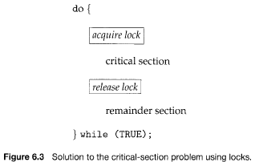
CS solution with locks using h/w
A simple tool requires-lock
Race conditions are prevented by requiring that critical section be protected by locks.

Slide 19
Synchronization Hardware
Many systems provide hardware support for critical section code
Uniprocessors – could disable interrupts while modified a shared variable
  Currently running code would execute without preemption.So no unexpected modifications could be made to the shared variable.
  This is the approach taken by non-preemptive kernels.
  Generally too inefficient on multiprocessor systems
    Operating systems using this not broadly scalable-time consumeing
Modern machines provide special atomic hardware instructions: TestAndSet ; Swap ;
    Atomic = non-interruptable
  Either test memory word and set value
  Or swap contents of two memory words

Slide 20
TestAndSet Instruction
Definition:
boolean TestAndSet (boolean *target)
{
boolean rv = *target;
*target = TRUE;
return rv:
}

Slide 21
Solution using TestAndSet
Shared boolean variable lock., initialized to false.
Solution:
do {
while ( TestAndSet (&lock ))
; // do nothing
// critical section
lock = FALSE;
// remainder section
} while ( TRUE);

Slide 22
Swap Instruction
Definition:
void Swap (boolean *a, boolean *b)
{
boolean temp = *a;
*a = *b;
*b = temp:
}

Slide 23
Solution using Swap
Shared Boolean variable lock initialized to FALSE; Each process has a local Boolean variable key.
Solution:
do {
key = TRUE;
while ( key == TRUE)
Swap (&lock, &key );
// critical section
lock = FALSE;
// remainder section
} while ( TRUE);

Slide 24
Semaphore Variables
Hardware based solution to the Critical Section (CS) problem are complicated for application programmer to use. To overcome this difficulty a synchronization tool called a semaphore can be used.
A semaphore is a protected integer variable that can facilitate and restrict access to shared resources in a multi-processing environment.
Semaphore S – integer variable ; can not modify directly. Using two standard operations we can modify S: wait() and signal()
Originally called P() and V() (Less complicated)

Slide 25
Semaphore Variable
    S: Semaphore;
P(S): while S ≤ 0 do skip;
S = S-1;
V(S): S = S+1;
P(S) and V(S) operations are atomic in nature that means when a process executing the process P(S) or V(S) that can not be Interrupted.
Using semaphore we can implement mutual exclusion very easily.

Slide 26
Semaphore Variable
P(S): while S ≤ 0 do skip;
S = S-1;
V(S): S = S+1;
mutex: Semaphore; mutex = 1;
P_{i}: P(mutex)
CS //Critical Section
V(mutex)
RS //Remainder Section

Slide 27
Semaphore Variable
We know a solution to the critical section problem must satisfy the following three requirement:
# Mutual exclusion
# Progress
# Bounded waiting
Semaphore Variable solves Mutual exclusion problem but still need to solve two more problems:

Slide 28
Two types of semaphore
Binary semaphore – If there is a single resource(CS) only , integer value can range only between 0 and 1; can be simpler to implement
  Also known as mutex locks
Binary semaphore initialized to 1
Provides mutual exclusion
Counting semaphore –If there are more than one but limited resources, integer value can range over an unrestricted domain

Slide 29
Problem!!!
Processes waiting on a semaphore must constantly check to see if the semaphore is not zero. This continual looping is clearly a problem in a real multiprogramming system (where often a single CPU is shared among multiple processes).
This is called busy waiting and it wastes CPU cycles. When a semaphore does this, it is called a spinlock.

Slide 30
Semaphore Implementation with no Busy waiting
To avoid busy waiting each semaphore there is an associated waiting queue of process that are waiting to access the critical section.
Rather than using a semaphore as a variable we can use it as a structure or record which have two fields:
  value (of type integer)
  list of the processes

Slide 31
Semaphore Implementation with no Busy waiting
Type declaration of semaphore as a record or structure:
  type semaphore = record
  value : integer;
  L : list of processor;
  end;

Slide 32
Semaphore Implementation with no Busy waiting
Two operations provide: block & wakeup
  OS provide the block() system call, which suspends the process that calls it, and the wakeup() system call which resumes the execution of blocked process P.
"No busy waiting" means that whenever the process wakes up from waiting, the condition it was waiting for should hold. That is, it must not wake up, find the condition false, and again wait on the same semaphore.

Slide 33
Semaphore Implementation with no Busy waiting
Structure semaphore{
int value;
queue L;
}
wait (S){
if (s.value > 0)
s.value=s.value-1;
else {
add this process S.L to waiting queue
block();
}
}
Signal (S){
if (S.L != Empty) {
remove a process S.L from the waiting queue;
wakeup(P); }
else {S.value=S.value+1;
}
}

Slide 34
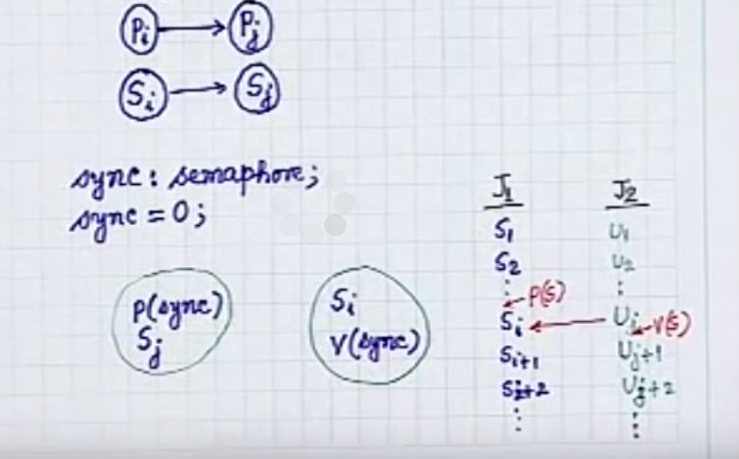
Process Synchronization using semaphore variable

Slide 35
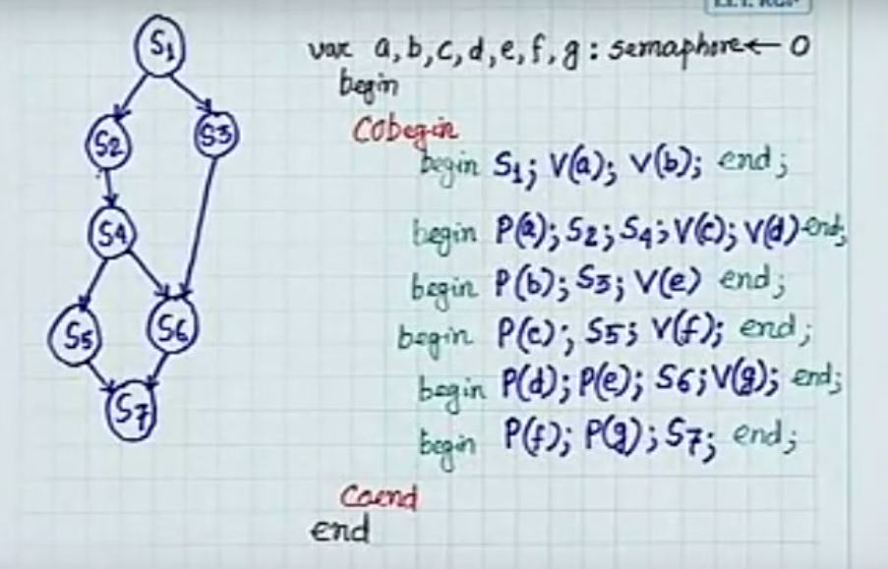
Process Synchronization using semaphore variable

Slide 36
Semaphore Implementation
Must guarantee that no two processes can execute wait () and signal () on the same semaphore at the same time
Thus, implementation becomes the critical section problem where the wait and signal code are placed in the crtical section.
  Could now have busy waiting in critical section implementation
    But implementation code is short
    Little busy waiting if critical section rarely occupied
Note that applications may spend lots of time in critical sections and therefore this is not a good solution.

Slide 37
Deadlock and Starvation
Deadlock – two or more processes are waiting indefinitely for an event that can be caused by only one of the waiting processes
Let S and Q be two semaphores initialized to 1
P₀ P₁
wait (S); wait (Q);
wait (Q); wait (S);
. .
. .
. .
signal (S); signal (Q);
signal (Q); signal (S);
Starvation – indefinite blocking. A process may never be removed from the semaphore queue in which it is suspended.

Slide 38
Classical Problems of Synchronization
Bounded-Buffer Problem
Readers and Writers Problem
Dining-Philosophers Problem

Slide 39
Bounded-Buffer Problem
The problem describes two processes, the producer and the consumer, who share a common, fixed-size buffer used as a queue. The producer's job is to generate a piece of data, put it into the buffer and start again. At the same time, the consumer is consuming the data (i.e., removing it from the buffer) one piece at a time.
The problem is to make sure that the producer won't try to add data into the buffer if it's full
and that the consumer won't try to remove data from an empty buffer.

Slide 40
Solution for Bounded-Buffer Problem
The solution for the producer is to either go to sleep or discard data if the buffer is full. The next time the consumer removes an item from the buffer, it notifies the producer, who starts to fill the buffer again.
In the same way, the consumer can go to sleep if it finds the buffer to be empty. The next time the producer puts data into the buffer, it wakes up the sleeping consumer.

Slide 41
Inadequate implementation
In the solution two library routines are used, sleep and wakeup. When sleep is called, the caller is blocked until another process wakes it up by using the wakeup routine. The global variable itemCount holds the number of items in the buffer.

Slide 42
Inadequate implementation
procedure producer() {
while (true) {
item = produceItem();
if (itemCount == BUFFER_SIZE) {
sleep();
}
putItemIntoBuffer(item);
itemCount = itemCount + 1;
if (itemCount == 1) {
wakeup(consumer);
}
}
}
procedure consumer() {
while (true) {
if (itemCount == 0) {
sleep();
}
item = removeItemFromBuffer();
itemCount = itemCount - 1;
if (itemCount == BUFFER_SIZE - 1) {
wakeup(producer);
}
consumeItem(item);
}
}
The problem with this solution is that it lead to a deadlock

Slide 43
it contains a race condition
The consumer has just read the variable itemCount, noticed it's zero and is just about to move inside the if block.
Just before calling sleep, the consumer is interrupted and the producer is resumed.
The producer creates an item, puts it into the buffer, and increases itemCount.
Because the buffer was empty prior to the last addition, the producer tries to wake up the consumer.
Unfortunately the consumer wasn't yet sleeping, and the wakeup call is lost. When the consumer resumes, it goes to sleep and will never be awakened again. This is because the consumer is only awakened by the producer when itemCount is equal to 1.
The producer will loop until the buffer is full, after which it will also go to sleep.
Since both processes will sleep forever, we have run into a deadlock. This solution therefore is unsatisfactory.

Slide 44
Using semaphores
Semaphores solve the problem of lost wakeup calls by using two semaphores, fillCount and emptyCount.
fillCount is the number of items already in the buffer and available to be read.
emptyCount is the number of available spaces in the buffer where items could be written.
fillCount is incremented and emptyCount decremented when a new item is put into the buffer.
If the producer tries to decrement emptyCount when its value is zero, the producer is put to sleep.
The next time an item is consumed, emptyCount is incremented and the producer wakes up. The consumer works analogously.

Slide 45
Using semaphores
semaphore fillCount = 0; // items produced
semaphore emptyCount = BUFFER_SIZE; // remaining space
procedure producer() {
while (true) {
item = produceItem();
down(emptyCount);
putItemIntoBuffer(item);
up(fillCount);
}
}
procedure consumer() {
while (true) {
down(fillCount);
item = removeItemFromBuffer();
up(emptyCount);
consumeItem(item);
}
}
The solution works fine when there is only one producer and consumer

Slide 46
With multiple producers and consumers
this solution contains a serious race condition that could result in two or more processes reading or writing into the same slot at the same time.
  It could contain two actions, one determining the next available slot and the other writing into it.

Slide 47
With multiple producers and consumers
  If the procedure can be executed concurrently by multiple producers, then the following scenario is possible:
  Two producers decrement emptyCount
  One of the producers determines the next empty slot in the buffer
  Second producer determines the next empty slot and gets the same result as the first producer
  Both producers write into the same slot

Slide 48
Using semaphores
To overcome this problem, we need a way to make sure that only one producer is executing putItemIntoBuffer() at a time.
semaphore mutex = 1;
semaphore fillCount = 0;
semaphore emptyCount = BUFFER_SIZE;
procedure producer() {
while (true) {
item = produceItem();
down(emptyCount);
down(mutex);
putItemIntoBuffer(item);
up(mutex);
up(fillCount);
}
}
procedure consumer() {
while (true) {
down(fillCount);
down(mutex);
item = removeItemFromBuffer();
up(mutex);
up(emptyCount);
consumeItem(item);
}
}
the order in which different semaphores are incremented or decremented is essential: changing the order might result in a deadlock.
Notes:
We use mutex to protect the update of buffer.

Slide 49
Readers-Writers Problem
Definition
There is a data area that is shared among a number of processes.
Any number of readers may simultaneously read to the data area.
Only one writer at a time may write to the data area.
If a writer is writing to the data area, no reader may read it.
If there is at least one reader reading the data area, no writer may write to it.
Readers only read and writers only write
A process that reads and writes to a data area must be considered a writer (consider producer or consumer)

Slide 50
Readers-Writers Problem
Problem!!!
allow multiple readers to read at the same time. Only one single writer can access the shared data at the same time.
If a writer and some other thread access the database simultaneously, chaos may ensure.
To ensure that these difficulties do not arise, we require that the writer have exclusive access to the shared database.
This synchronization problem is referred to as readers-writers problems.

Slide 51
Readers-Writers Problem
The reader-writers has several variations, all involving priorities.
  first reader-writers problem, requires that no reader will be kept waiting unless a writer has already obtained permission to use the shared object. In other words no reader should wait for other reader to finish simply because a writer is waiting.
  second reader-writers problem- requires that, once a writer is ready, that writer performs it write as soon as possible. In other words if a writer is waiting to access the object, no new readers may start reading.

Slide 52
Readers-Writers Problem
As solution to either problem may result in starvation.
In the first case writers may starve and in the second case readers may starve.
For this reason other variant of the problem have been proposed.
  the third readers-writers adds the constrain that know thread shall be allowed to starve; that is the operation of obtaining a lock on the shared data will always terminate in a bounded amount of time.

Slide 53
Readers-Writers Problem
The solution of the first Reader-writer problem:
Shared Data
  Data set
  Semaphore mutex initialized to 1.
  Semaphore wrt initialized to 1.
  Integer readcount initialized to 0.
  The semaphore wrt is common to both reader and writer processes.
  The mutex semaphore is used to ensure mutual exclusion when the variable readcount is updated. The readcount variable keeps track of how many processes are currently reading the object.

Slide 54
Readers-Writers Problem (Cont.)
The structure of a reader process
do {
wait (mutex) ;
readcount ++ ;
if (readercount == 1) wait (wrt) ;
signal (mutex)
// reading is performed
wait (mutex) ;
readcount -- ;
if (redacount == 0) signal (wrt) ;
signal (mutex) ;
} while (true)
● Needs mutually exclusive access while manipulating “readers” variable
● Does not need mutually exclusive access while reading database
● If this reader is the first reader, it has to wait if there is an active writer (which has exclusive access to the database) n First reader did a “P(write)”
● If other readers come along while the first one is waiting, they wait at the “P(mutex)”
● If other readers come along while the first one is actively reading the database, they can also get in to read the database
● When the last reader finishes, if there are waiting writers, it must wake one up

Slide 55
Readers-Writers Problem (Cont.)
The structure of a writer process
do {
wait (wrt) ;
// writing is performed
signal (wrt) ;
} while (true)
If there is an active writer, other writer has to wait (the active writer has exclusive access to database)
If there are active readers, this writer has to wait (readers have priority) n First reader did a “P(write)”
The writer only gets in to write to the database when there are no other active readers or writers
When the writer finishes, it wakes up someone (either a reader or a writer it’s up to the CPU scheduler)
If a reader gets to go next, then once it goes through the “V(mutex)” and starts reading the database, then all other readers waiting at the top “P(mutex”) get to get in and read the database as well

Slide 56
Dining-Philosophers Problem
Problem statement
Five silent philosophers sit at a round table with bowls of spaghetti. Forks are placed between each pair of adjacent philosophers.
Each philosopher must alternately think and eat. However, a philosopher can only eat spaghetti when he has both left and right forks. Each fork can be held by only one philosopher and so a philosopher can use the fork only if it is not being used by another philosopher. After he finishes eating, he needs to put down both forks so they become available to others. A philosopher can take the fork on his right or the one on his left as they become available, but cannot start eating before getting both of them.
Eating is not limited by the remaining amounts of spaghetti or stomach space; an infinite supply is assumed. assuming that no philosopher can know when others may want to eat or think.

Slide 57
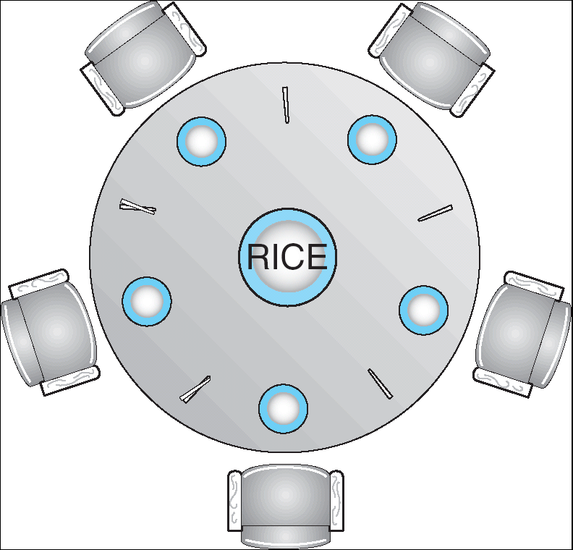
Dining-Philosophers Problem
Shared data
  Bowl of rice (data set)
  Semaphore chopstick [5] initialized to 1

Slide 58
Dining-Philosophers Problem (Cont.)
The structure of Philosopher i:
    Do {
    wait ( chopstick[i] );
    wait ( chopStick[ (i + 1) % 5] );
    // eat
    signal ( chopstick[i] );
    signal (chopstick[ (i + 1) % 5] );
    // think
    } while (true) ;

Slide 59
Dining-Philosophers Problem
Must satisfy mutual exclusion - no two philosopher can use the same fork at the same time.
Avoid deadlock and starvation!

Slide 60
Dining-Philosophers Problem
First attempt: take left fork, then take right fork
Wrong! Results in deadlock.
Second attempt: take left fork, check to see if right is available, if not put left one down. Still has race condition and can lead to starvation.

Slide 61
Suggestion to solve the problem
Allow at most four philosophers to be sitting simultaneously at the table.
Allow a philosopher to pick up her chopsticks only if both chopsticks are available.
An odd philosopher picks up her left chopstick first and even philosopher picks up her right chopstick first.

Slide 62
End of Chapter 6

